Slide 1


TOOLS, SERVICES
& SUPPORT

Slide 2
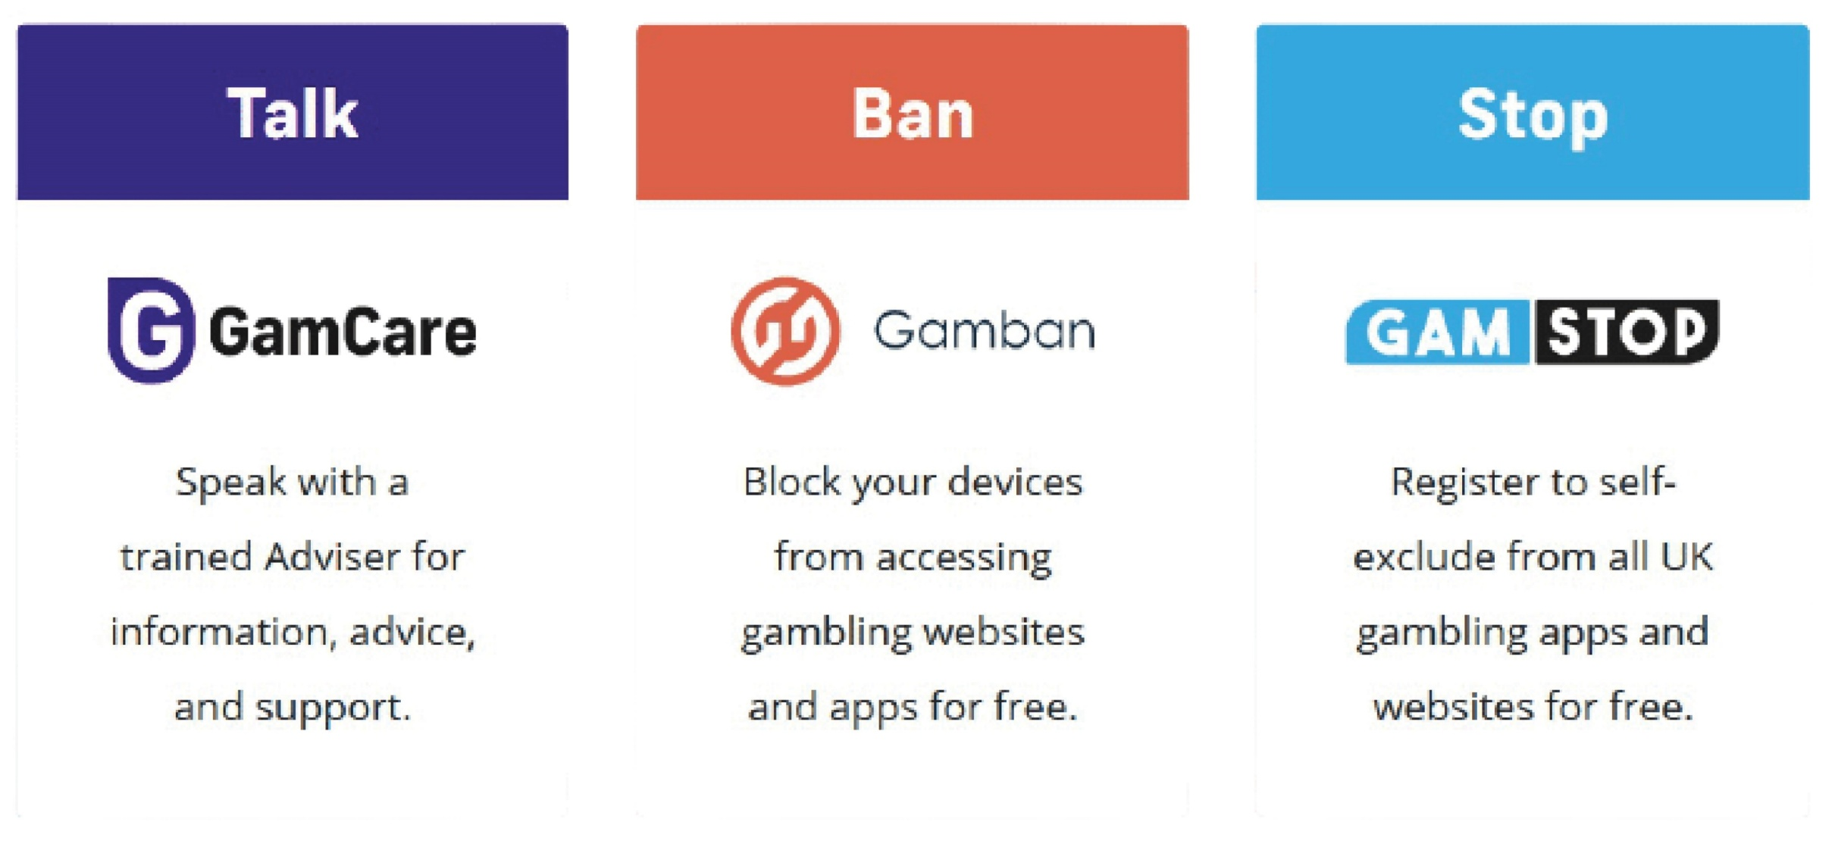
www.TalkBanStop.com

Slide 3
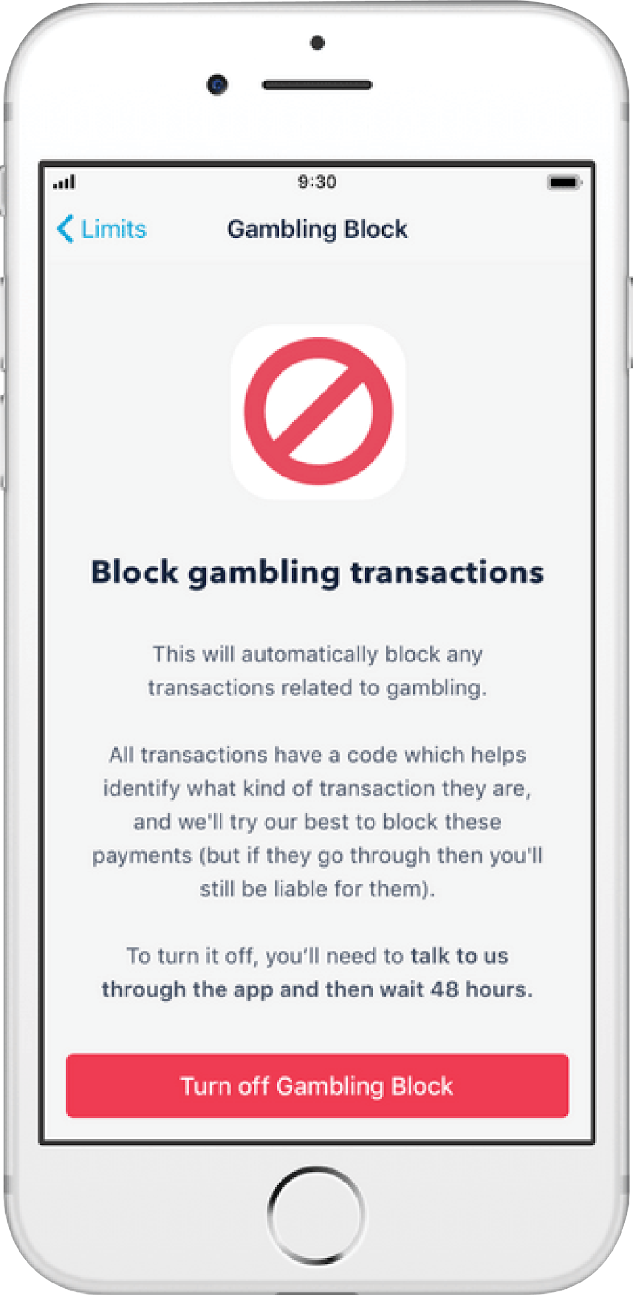

THE GAMBLING BLOCK
The gambling block is a feature that allows you to block your bank account/bank card from being used for gambling transactions.

Slide 4


The NHS National Centre for Behavioral Addictions includes the National Problem Gambling Clinic, the Young Persons' Problem Gambling Clinic and the National Centre for Gaming Disorders.

Slide 5


SUPPORT FOR FAMILY MEMBERS...
GamFam offer support through GRA5P – The GamFam Recovery and Support Programme. GRA5P is a structured 5-stage self-help peer support programme.
[www.gamfam.org.uk]
If you are affected by someone else’s gambling then Gam-Anon can help. Gam-Anon hold in-person meetings for anyone who has been affected by a loved one’s gambling
[www.gamanon.org.uk]

Slide 6


StepChange debt charity can help with any debt problems that may have arisen from a gambling addiction.
National Debtline is charity that gives free and independent debt advice over the phone and online.
0800 138 1111
0808 808 4000
www.stepchange.org
www.nationaldebtline.org

Slide 7
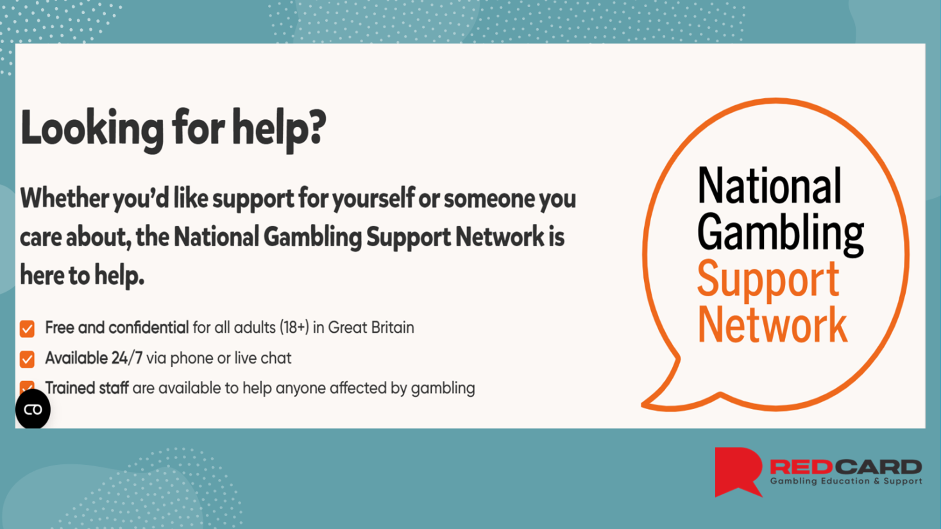

Slide 8


Your 5 steps to recovery
Acknowledge and accept
Ask for help
Seek professional support
(not one size fits all)
Self-exclude/self-regulation
Sustainable recovery

Slide 9
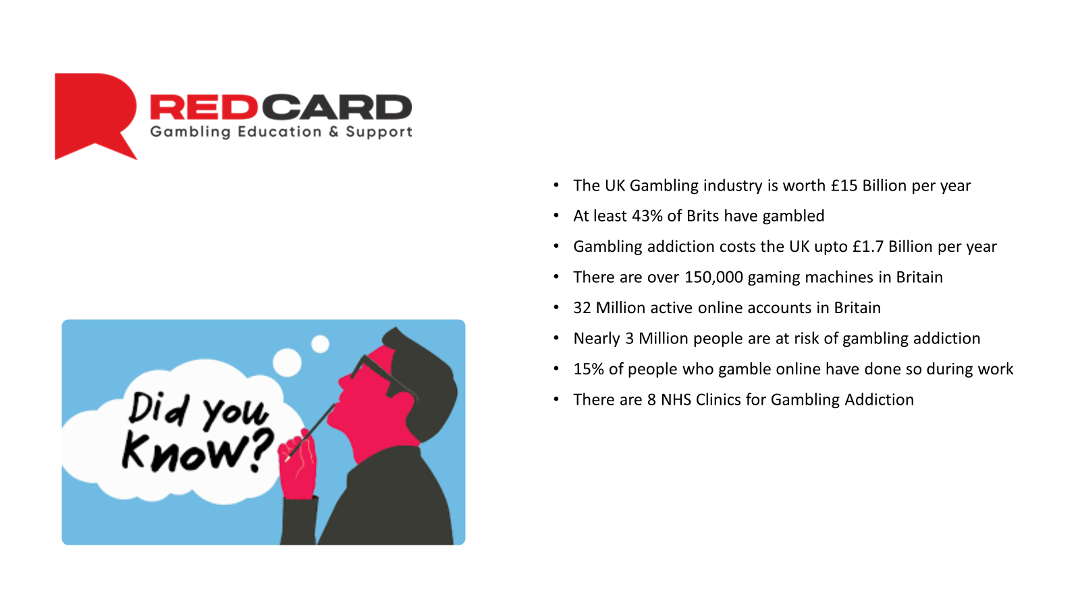
The UK Gambling industry is worth £15 billion per year.
At least 43% of Brits have gambled
Gambling addiction costs the UK up to £1.7 billion per year.
There are over 150,000 gaming machines in Britain.
32 Million active online accounts in Britain.
Nearly 3 million people are at risk of gambling addiction.
15% of people who gamble online have done so during work.
There are 8 NHS Clinics of gambling addiction.

Slide 10
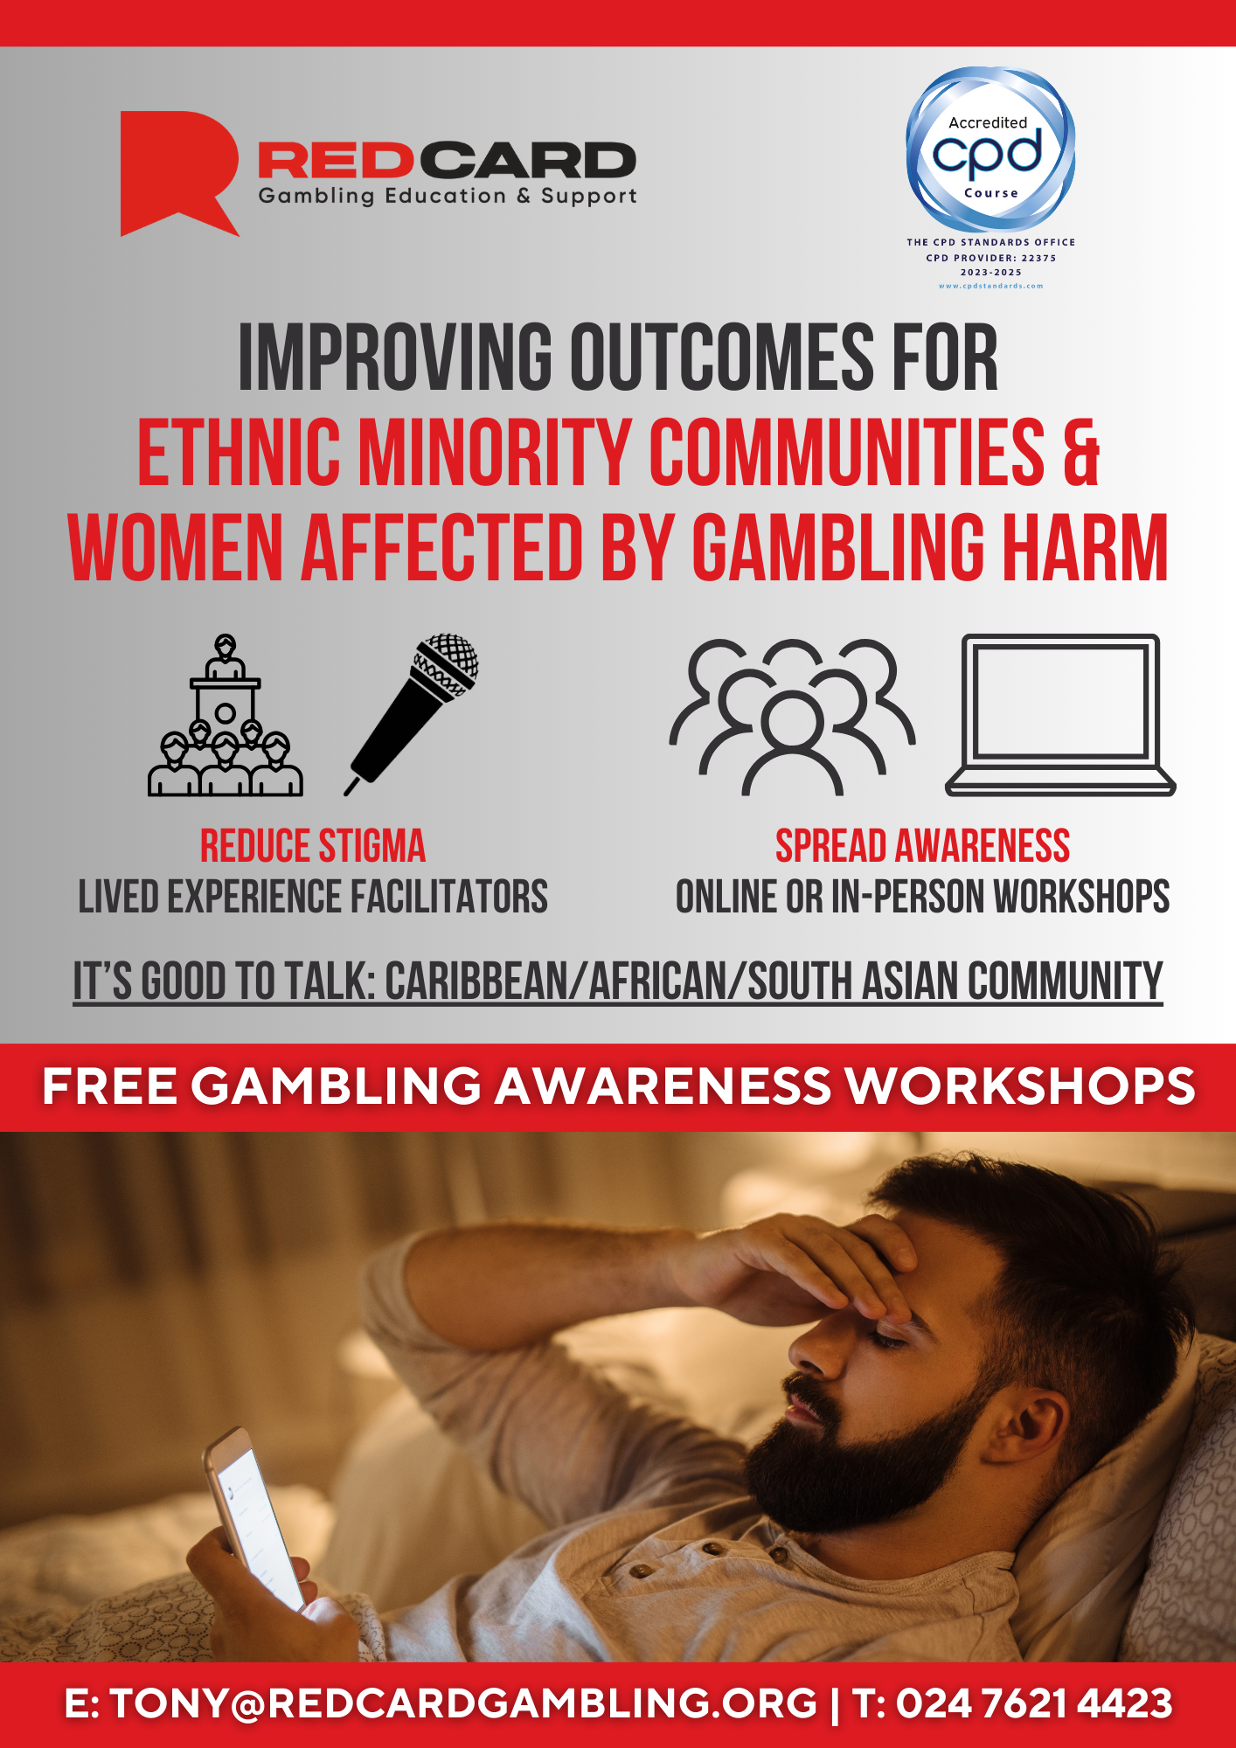
Gambling within ethnic minority groups is something that is not highlighted enough, and the shame and stigma that is attached to gambling within these cohort groups is a vehicle to gambling related harms.
Red Card are educating ethnic minority groups, particularly those from the Caribbean, African, and South Asian communities on gambling related harms, and are proud to be at the forefront of this project [launched May 2024]
Those from ethnic minority backgrounds are 4 times more likely to suffer gambling harms than their white British counterparts [Source: GambleAware]

Slide 11


Slide 12
Red Card Gambling Support
If anyone has issues around their gambling, or wants to support anyone who may be struggling with their gambling, please contact us at the earliest possible opportunity. We will make sure you get the support you need.
Website: www.redcardgambling.org
Email: info@redcardgambling.org
Phone: 02476 214 423

